Slide 1
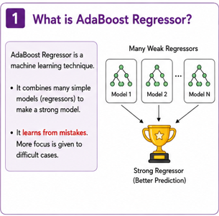
ADABOOST REGRESSION
Adaptive Boosting

Slide 2
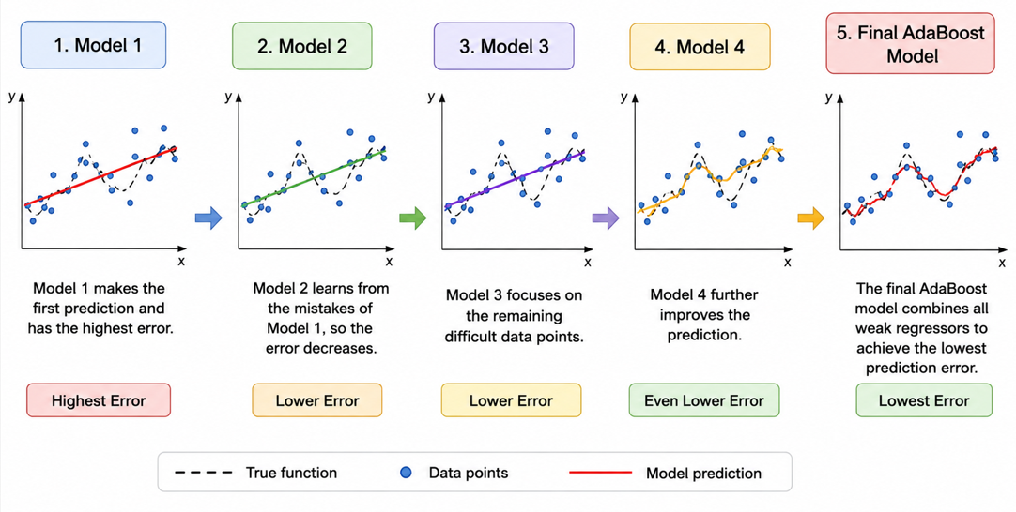

Slide 3
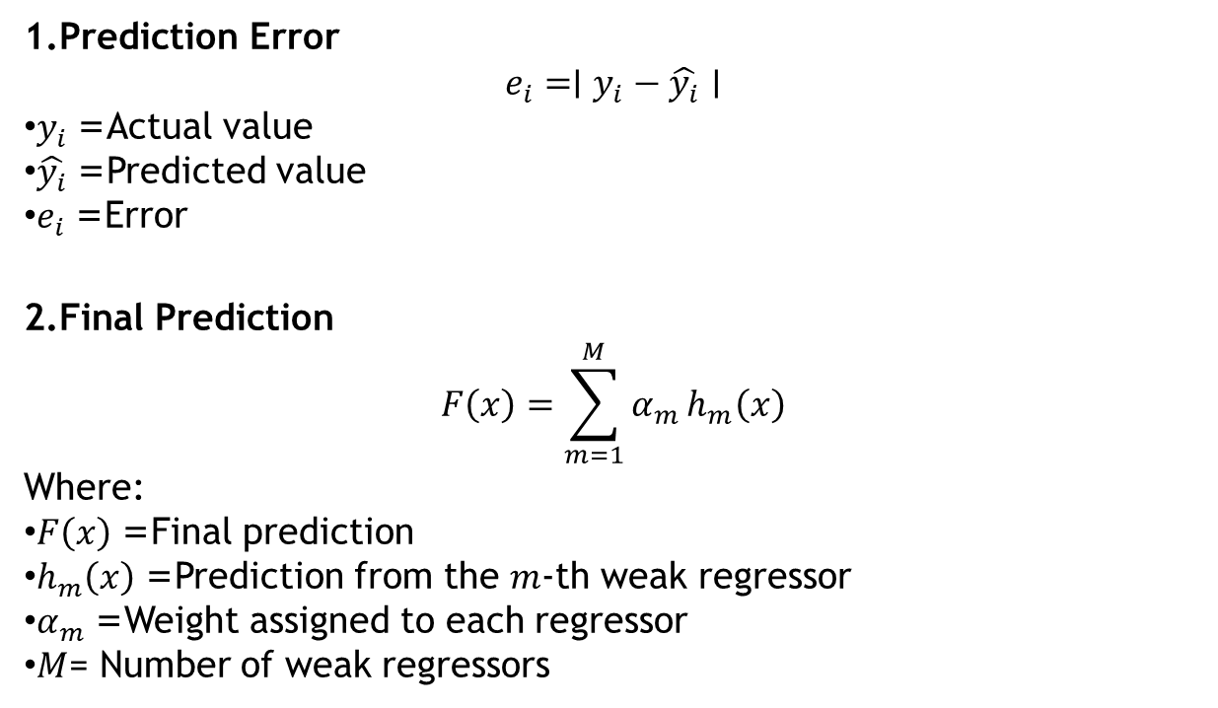
Prediction Error
$$e_{i}=∣y_{i}−\hat{y_{i}}∣$$
$y_{i}$= Actual value
$\hat{y_{i}}$= Predicted value
$e_{i}$= Error
Final Prediction
$$F\left(x\right)=\sum_{m=1}^{M}{α_{m}}h_{m}\left(x\right)$$
Where:
$F\left(x\right)$= Final prediction
$h_{m}\left(x\right)$= Prediction from the $m$-th weak regressor
$α_{m}$= Weight assigned to each regressor
$M$= Number of weak regressors

Slide 4
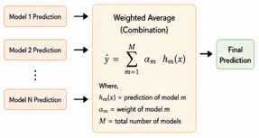
How predictions are combined?

Slide 5
